Slide 1
Calisthenics AI
PIP2001 Capstone Project Review-1
Batch Number: 2025
Under the Supervision of
Mr. Muthuraju V
Assistant Professor
School of Computer Science
and Engineering
Presidency University
Roll Number | Student Name
20211CEI0048 | Ammar Hanif Khatri
20211CEI0018 | Sai Lavanya Patnaik
20211CEI0147 | Giftson Sam Paul
Name of the Program: Computer Engineering spl in AI and ML
Name of the HoD: Gopal Shyam
Name of the Program Project Coordinator:
Name of the School Project Coordinators: Dr. Sampath A K / Dr. Abdul Khadar A / Mr. Md Ziaur Rahman

Slide 2
Content
Title
Abstract
Literature Survey
Minimum 10 research papers must be referred.
Objectives
Existing Methods-Drawbacks
Proposed Method
Architecture Diagram
Modules
Hardware and Software Details
Time Line by Gantt Chart
References

Slide 3
Problem Statement Number:
Problem Description:
Individuals looking to start calisthenics or bodyweight strength training often face a lack of accessible, personalized workout plans. Most available options are either expensive or provide generic routines that don't consider the specific goals, fitness levels, or preferences of users. For beginners, this issue is compounded by the absence of a dedicated system that caters specifically to those starting out in calisthenics. Without proper guidance or affordable, customizable options, many newcomers feel overwhelmed or discouraged, preventing them from effectively beginning their strength training journey and achieving their fitness goals.
Difficulty Level: Complex

Slide 4
Analysis of Problem Statement
Technology Stack Components:
Frontend: Streamlit
Backend: RAG-Based Chatbot using GPT
Knowledge Base: Store workout data (plans, exercises, routines, tips).
Integration: Connect to fitness trackers, calendars, or other tools.
Deployment: Use Streamlit Cloud.

Slide 5
Analysis of Problem Statement (contd...)
Software Requirements:
Programming Language: Python 3.7+
Frontend: Streamlit, streamlit-chat
Backend and Chatbot Integration: OpenAI API, Haystack, LangChain
Data Storage and Retrieval: Vector Store Retriever (FAISS, Pinecone, Weaviate)
Deployment: Streamlit Cloud

Slide 6
Analysis of Problem Statement (contd...)
Lack of Personalized Workout Plans: Many existing solutions are either too generic or expensive, making them inaccessible to beginners.
Ineffective Training: Generic workout plans may not suit individual fitness levels and goals, leading to ineffective training and discouragement.
Lack of Personalized Guidance: Beginners often lack the necessary guidance to optimize their workouts based on their unique physical conditions, goals, and preferences.
Limited Customization: Current systems often lack the customization needed to achieve the best possible results from training.
Market Opportunity: There is a significant opportunity to develop an affordable application that provides personalized workout plans for calisthenics

Slide 7
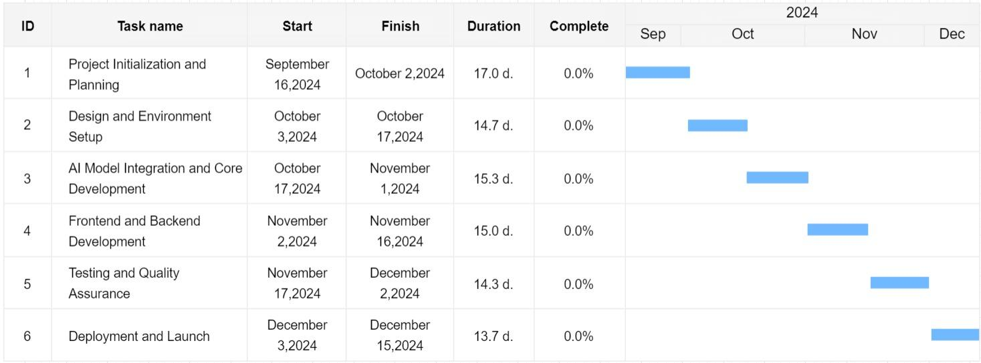
Timeline of the Project (Gantt Chart)

Slide 8
References (IEEE Paper format)
[1] S. Vakayil, D. S. Juliet, A. J., & S. Vakayil. "RAG-Based LLM Chatbot Using Llama-2." 2024 7th International Conference on Devices, Circuits and Systems (ICDCS), Coimbatore, India, 2024, pp. 1-5. doi:10.1109/ICDCS59278.2024.10561020.
[2]A. Jadhav, S. Unkule, D. Hadsul, Y. Chiddarwar, & P. Padhy. "Workout Whiz – Your Personalized AI PAL." 2023 6th International Conference on Advances in Science and Technology (ICAST), Mumbai, India, 2023, pp. 490-493. doi:10.1109/ICAST59062.2023.10455053.
[3]S. A., V. A., A. M., G. S., & N. M. "Fitness Guide: A Holistic Approach for Personalized Health and Wellness Recommendation System." 2024 International Conference on Advances in Data Engineering and Intelligent Computing Systems (ADICS), Chennai, India, 2024, pp. 01-06. doi:10.1109/ADICS58448.2024.10533529.
[4] M. Pillai & P. Thakur. "Developing a Website to Analyze and Validate Projects Using LangChain and Streamlit." 2024 2nd International Conference on Intelligent Data Communication Technologies and Internet of Things (IDCIoT), Bengaluru, India, 2024, pp. 1493-1501. doi:10.1109/IDCIoT59759.2024.10467765

Slide 9
[5]D. Chowdhury, A. Roy, S. R. Ramamurthy and N. Roy, "CHARLIE: A Chatbot That Recommends Daily Fitness and Diet Plans," 2023 IEEE International Conference on Pervasive Computing and Communications Workshops and other Affiliated Events (PerCom Workshops), Atlanta, GA, USA, 2023, pp. 116-121, doi: 10.1109/PerComWorkshops56833.2023.10150359. keywords: {Pervasive computing;Schedules;Obesity;Conferences;Chatbots;Market research;Task analysis;e-Health;Fitness;Diet;Deep Learning;Feed-Forward Neural Networks;Recommendation Systems},

Slide 10


